Slide 1
iWay Product Innovations
2011 Midyear Review / Technical Roadmap
Marc J. Greenberg
Chief Software Architect
iWay Software

Slide 2
Timeline
Sep 2008 Gartner Event Processing Summit
Oct 2008 Research And Development Starts
2009
2010
2011
Q1
Q2
Q3
Q4
Q1
Q2
Q3
Q4
Q1
Q2
Q3
Q4
Enable 1.0
ism 5.6
jre 1.5
1.3.0.2
ism 6.1DF
jre 1.6
Enable 1.1
ism 5.6 6.0
jre 1.5
1.3.0.1
ism 6.1 Alpha
jre 1.6
Enable 1.3
ism 6.1 jre 1.6
Enable 1.2
ism 6.0.1
jre 1.5
1.3.X 1.4X
2.X
Agile Scrums
4 Sprints Completed. Training Completed.
Scrum Methodology Confirmed, Tools acquired / validated.
Enable 1.3 Delivery on Target for July 4th 2011
Notes:
http://agilemanifesto.org/principles.html

Slide 3
Things Still Under Consideration in 2011
Architectural
  My Enable
  Metadata Integration
  Policy Management
  Identity Management
Product Merge
(remove redundancies)
  Enable + iRules
  Enable + BAM
  XML Archive
Trends/Business Zeitgeist – The Spirit of Now
  Agile
  Cloud / Spring
  Mobile
  Data Science
Productization
  Demos, Doc,
  Best Practices
  Packaging
  Marketing
Notes:
Our highest priority is to satisfy the customer through early and continuous delivery of valuable software.

Slide 4






Mobile Devices
Web Design for all Mobile Platforms
  Platform/Browser Specific
  Update All Visualizations
  HTML5
Native apps support
  Indirectly: Social
  Directly: MyEnable app

Slide 5


MyEnable
MyEnable
Events
Dashboards
Rules
Integration

Slide 6

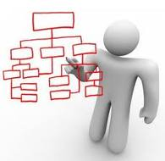

Identity Management: Domains
Who am I?
Social
Business
Corporate

Slide 7
Spring / SpringSource / Cloud
SaaS, PaaS,
IaaS, STaaS
EMC (16)
VMWare (3)
SpringSource
iWay Software
Information Builders

Slide 8
Data Science is Information Building
Data Acquisition
  Social Media, Feeds
  Web Crawlers
  Internal Data Sources
Data Cleansing
  Scrubbing
  Proper ETL Queries
  Key-Value pairs etc
Data Modeling
  Interpret using Analytics
  Multivariate statistics
  NLP, Machine Learning
Data Visualization
  Presentation
  Communication
Data Semantics
  Translate to Information
  Answer Business Questions
Data Science is Information Builders
Notes:
What is Data Science?
The ability to take data -- to be able to understand it, to process it, to extract value from it, to visualize it, to communicate it
Data scientist investigates, analyzes, reduces and reports
Problem space defined by following events and
Discovering patterns based on event properties
Enables the creation of data products
http://radar.oreilly.com/2010/06/what-is-data-science.html

Slide 9
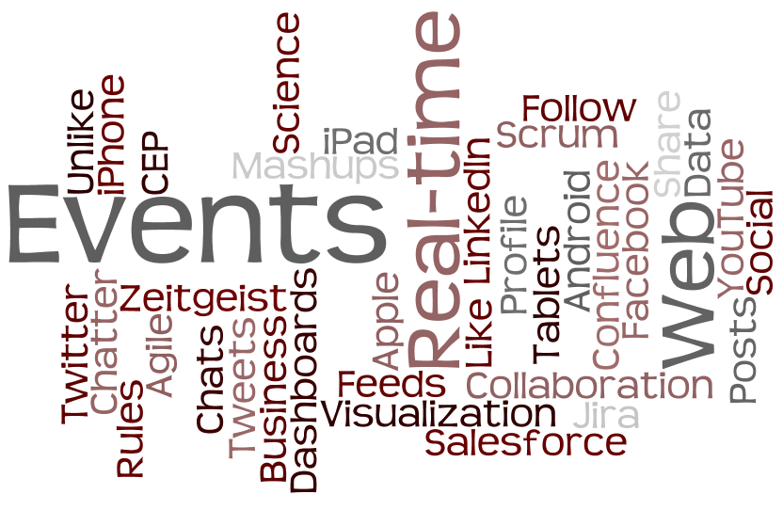
Terminology / Nomenclature
www.wordle.net

